Slide 1
Ipl Team Analysis
When individuals with diverse perspectives collaborate towards a common objective, the outcome is often improved, referred to as a team effort.
By: Love Tiwadi

Slide 2
Data
We have the data of 235 different players.
Players are being measured by different aspects like strike rates, runs, catches, wickets, stumps, etc
This data also consists of Nan values which need to be taken care of.
This data consists of 16 columns which include different aspects of cricket.

Slide 3
Highlights from EDA
Batsman
Bowlers
All-rounders
Keepers
Top 5 batsman :
Virat Kohli
Shikhar Dhawan
Rohit Sharma
David Warner
Robin Uthappa
Top 5 bowlers:
Daniel Sams
Tushar Deshpande
Navdeep Saini
Tim Southee
Adam Milne
Top 5 All-rounders
Kieron Pollard
Ravindra Jadeja
Benny Howell
Glen Maxwell
Nitish Rana
Top 5 keepers:
MS Dhoni
Dinesh Karthik
Wridhhiman-Saha
Rishabh Pant
Quinton De knock

Slide 4
Final team through analysis
Team of 11 players:
Virat Kohli
Shikhar Dhawan
Rohit Sharma
David Warner
Daniel Sams
Tushar Deshpande
Navdeep Saini
Kieron Pollard
Ravindra Jadeja
Benny Howell
Glen Maxwell

Slide 5
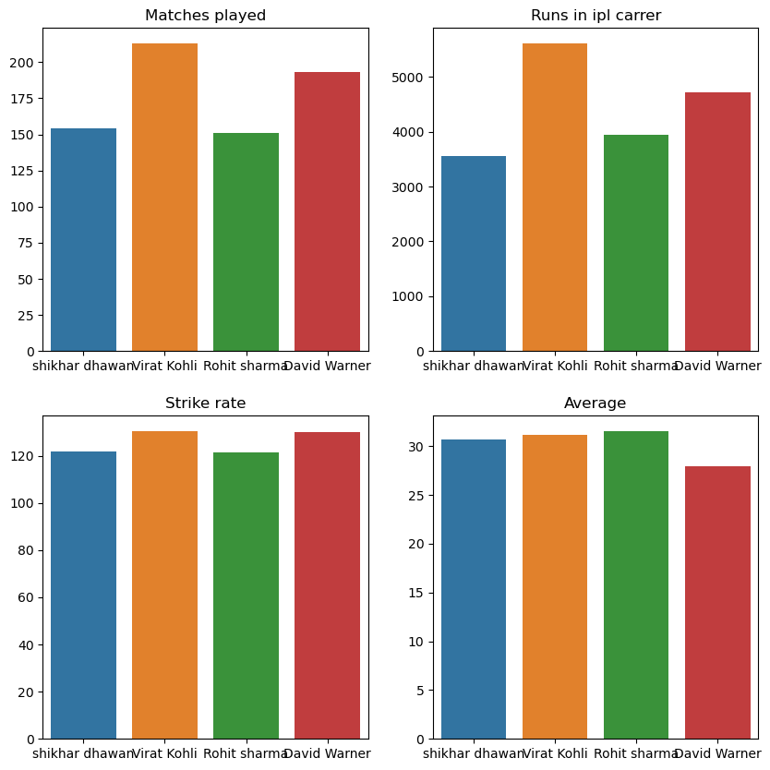
Interesting findings
Top 4 batsman

Slide 6
Conclusion/Future work
The final team consists of 4 batsmen 3 bowlers 4 allrounders.
Future work
To make this model more efficient with Machine learning algorithms.

